Slide 1
Mini Project - II
“ Power Conversion using Windmill ”
Student Name USN
Divya Shree R 1NH18EC711
Devika K 1NH18EC130
Sahana Y 1NH18EC131
Sharanya K N 1NH18EC747
Guided By
Ms. Rajashree
Senior Assistant Professor
Dept. of ECE
New Horizon College Of Engineering

Slide 2
Contents
Introduction
Literature Review
Existing System
Problem Statement & Objectives
Proposed System
Block Diagram
Hardware & Software Specification
Circuit Diagram & Working
Results & Discussion
Advantages
Conclusion & Future Scope
References
Progress Work
Milestones/Schedule

Slide 3

Introduction
The wind energy is an environment friendly and efficient source of renewable energy. The kinetic energy of the wind can be used to do work.
The energy is harnessed by windmill in the past to do mechanical work. This is used for water lifting pumps and generating electricity.
To generate the electricity, the rotary motion of, the windmill is used to turn the turbine of the electric generator.
The output of the single windmill is quite small and cannot be used for commercial purposes. Therefore, number of windmills are erected over large area which is known as wind energy farm.
The each every windmill is coupled together to get electricity for commercial purposes.
The wind speed should be higher than 15km/hr.

Slide 4
Literature Review
Title of the paper | Author & Year of Publication | Outcome | Limitation
Low-voltage ride-through of varaiable speed with turbines with permanent magnet synchronous generator | Fujin Deng | Gear box is not used, only two straight bevel or spiral bevel gear is used (driver and driven gear). The power output is double compare to single windmill. | Maintenance is important and high. Design is complement for gear and rotor turbine

Slide 5
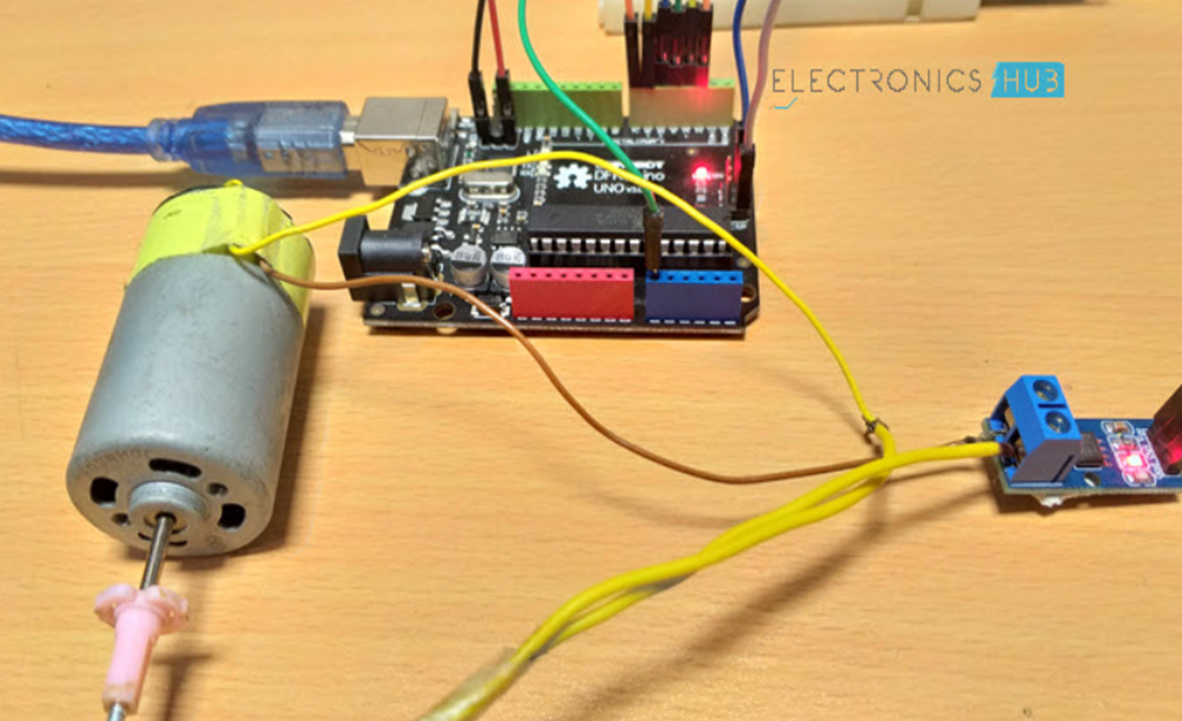
Existing System

Slide 6
Problem Statement & Objectives
Problem Statement:
Generation of current from a renewable energy
Objectives:
Generation of more power
high efficiency
Build an eco-friendly model for the power generation and also for conversion of the energy
Microcontroller will accurately measure the output generated by windmill.

Slide 7

Proposed System
Principle : The windmill works on the principle of generating power through the force of the nature (air). The blades of the windmill will rotates due to the force of wind strike them. The rotating blades are transmitting the power to the generator.
Components Required: Arduino UNO, ASC712 Current Sensor Module, Load (like a lamp or a motor), Power supply (for load like battery), 16×2 LCD Display, 10KΩ Potentiometer, 330ohms Resistor, Connecting wires

Slide 8
Measuring voltages (DC Voltages) with Arduino is very easy. If your requirement is to measure less than or equal to 5V, then you can directly measure using the Arduino Analog Pins. If you need to measure more than 5V, then you can use a simple voltage divider network or a voltage sensor module.
When it comes to measuring current, Arduino (or any other microcontroller) needs assistance from a dedicated Current Sensor. So, Interfacing an ACS712 Current Sensor with Arduino helps us in measuring current with the help of Arduino.
As ASC712 can be used for measuring either AC or DC currents, Arduino can be implemented to measure the same.

Slide 9
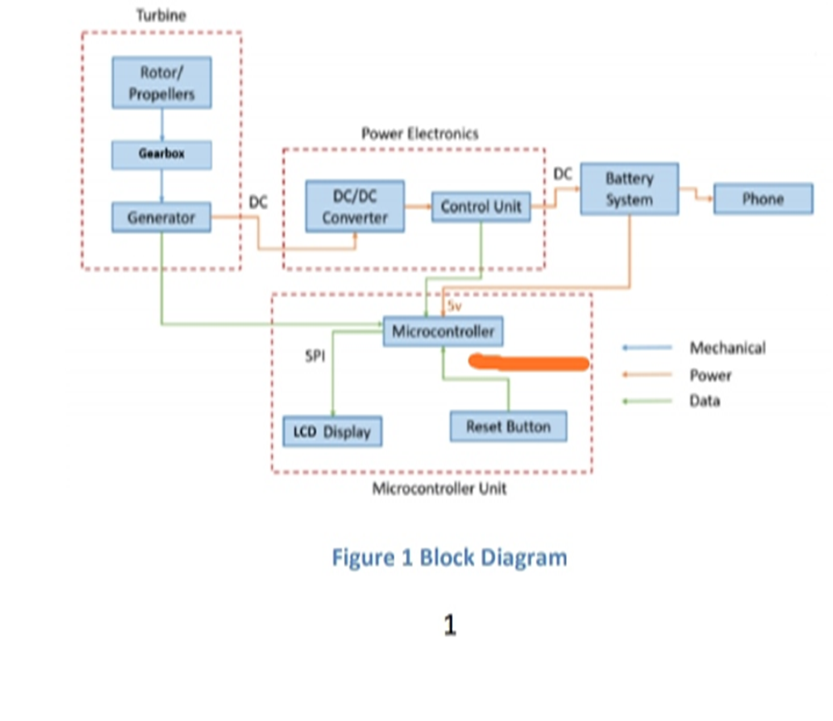
Block Diagram

Slide 10
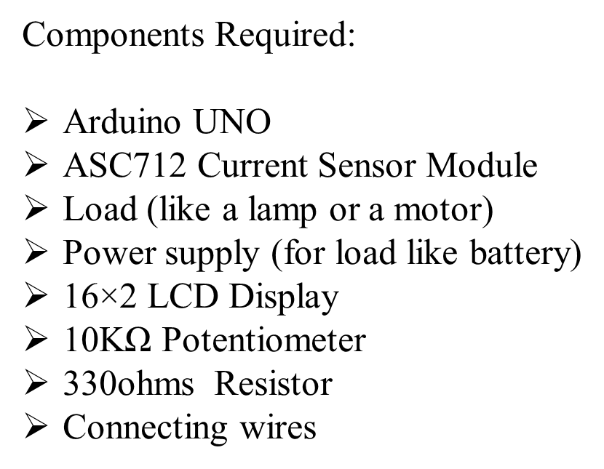
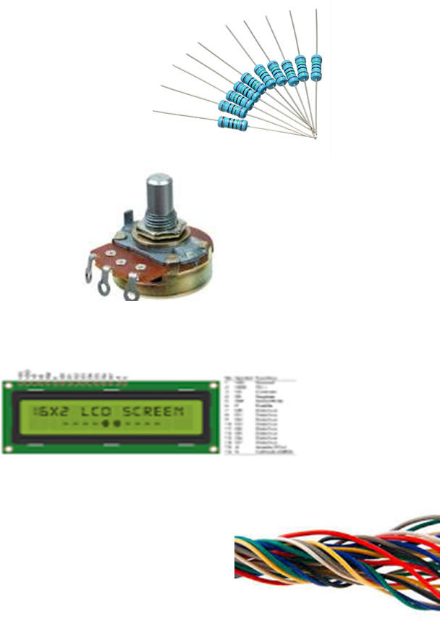
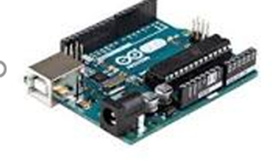
Hardware & Software Specification

Slide 11
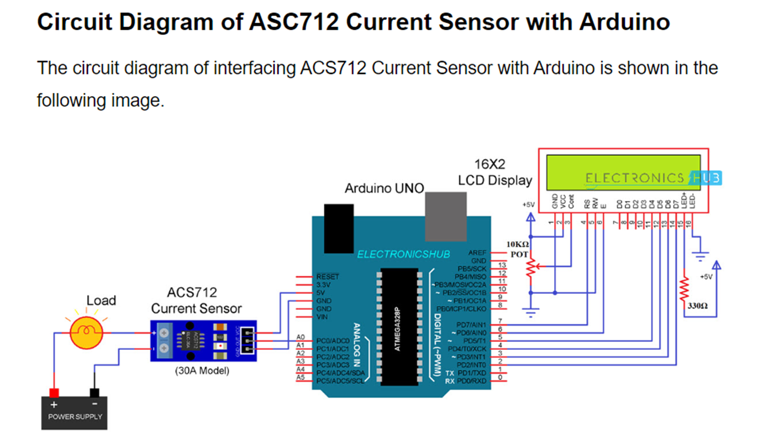
Circuit Diagram & Working

Slide 12
Results & Discussion
Wind energy is converted to electrical energy, current generated is observed through LCD screen. Phone is charged from the power generated.

Slide 13
Advantages
It generates more power
• It is not necessary connect the same generator and also connect different generator in serious shaft
• We will use all type of generators like permanent magnet D.C. generator, synchronous generator and induction generator
• Gear box is not used, only two straight bevel or spiral bevel gear is used (driver and driven gear)
• The power output is double compare to single windmill.

Slide 14
Conclusion & Future Scope
Conclusion: With the help of wind energy we are able to charge a electronic gadget.
Future Scope:
future work includes better integration of the parts, reducing the weight of the turbine as well as increasing the efficiencies of the modules that make up the system. The weight of the turbine could be reduced by implementing a smaller mechanical design. There are much lighter parts available and the gearbox could easily be refined to take up less space, create less drag, and be lighter. The power electronics could be made more efficient since some parts ended up oversized. Additionally, safety features like braking

Slide 15
References
1] M. Ragheb, “Vertical Axis Wind Turbines”, University of Illinois at Urbana-Champaign, March 2015
[2] F. Sigernes, “Draft: Savonius Wind wind rotor basics”, University Centre in Svalbard, Norway, 2015[Accessed Feb 10. 2018]
[3] M. Ragheb, “Vertical Axis Wind Turbines”, University of Illinois at Urbana-Champaign, March 2015[Accessed Feb 6. 2018]

Slide 16
Progress Work
Ppt and report are completed.
Circuit in progress.
Few of the components are purchased.
Dumping of code to aurdino is completed.

Slide 17
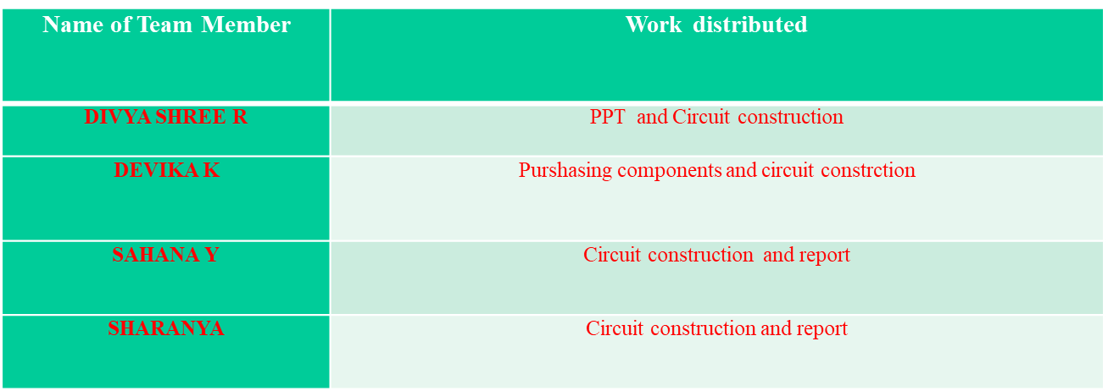
Milestones/Schedule

Slide 18
Thank You

